Slide 1
Introduction to Tableau
Part 9
Notes:
Welcome back to Data Society! We have a great class ahead of us today.

Slide 2
Warm-up: top LOD functions
In the last module, we discussed a few different types of function, including LOD (level of detail) functions.
Skim through the following blog post:
Top 15 Tableau LOD Expressions (Practical Examples) [link]
How might some of these functions apply to your Capstone data or data you may encounter in future projects?
Notes:
The purpose of this slide is to help students think about how to adapt Tableau help materials to suit their purposes. ALLOW students 5-7 minutes to skim through the blog post on LOD expressions. ASK the question at the bottom of the slide, then COMMENT on their responses. The total time for this activity should be about 15 minutes.

Slide 3
Module completion checklist
Objective | Complete
Implement string calculations on a given dataset
Implement date calculations on a given dataset
Implement type calculations on a given dataset
Implement logic calculations on given dataset

Slide 4
Recap: function types
Just like SQL functions, Tableau functions are classified into several types.
These include:
Number Functions
String Functions
Date Functions
Type Conversion
Logical Functions
Aggregate Functions
Pass-Through Functions (RAWSQL)
User Functions
Table Calculation Functions
Spatial Functions
Additional Functions
To see Tableau functions separated by type, visit this page [link]
Notes:
The purpose of this slide is to introduce the typology of functions native to Tableau. COMPARE these categories to the function types in SQL. EXPLAIN what some of these function types mean, especially Number Functions and Aggregate Functions (since they’re the next function types you’ll be exploring in detail on Day 4).

Slide 5
String functions
String functions allow you to manipulate string data (i.e. text data).
Using string functions, you can perform a lot of common operations:
Capture part of a field.
Recast part of a string as an int.
Clean messy data.
Remove extraneous fields.
Notable functions include MID, REPLACE, and TRIM, which we will practice using on the country data today.
Notes:
The purpose of this slide is to introduce the concept of string functions and outline the next few slides.

Slide 6
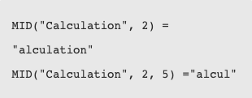
String function: MID
MID
Returns the string starting at a particular position.
If the optional argument length is added, the returned string includes only that number of characters.
Example:
Notes:
The purpose of this slide is to define the MID function.

Slide 7
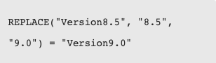
String function: REPLACE
REPLACE
Searches a string for a substring and replaces it with a replacement substring.
Example:
Notes:
The purpose of this slide is to define the REPLACE function.

Slide 8
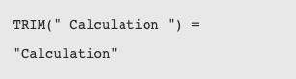
String function: TRIM
TRIM
Returns the string with leading and trailing spaces removed.
Example:
Notes:
The purpose of this slide is to define the TRIM function.

Slide 9
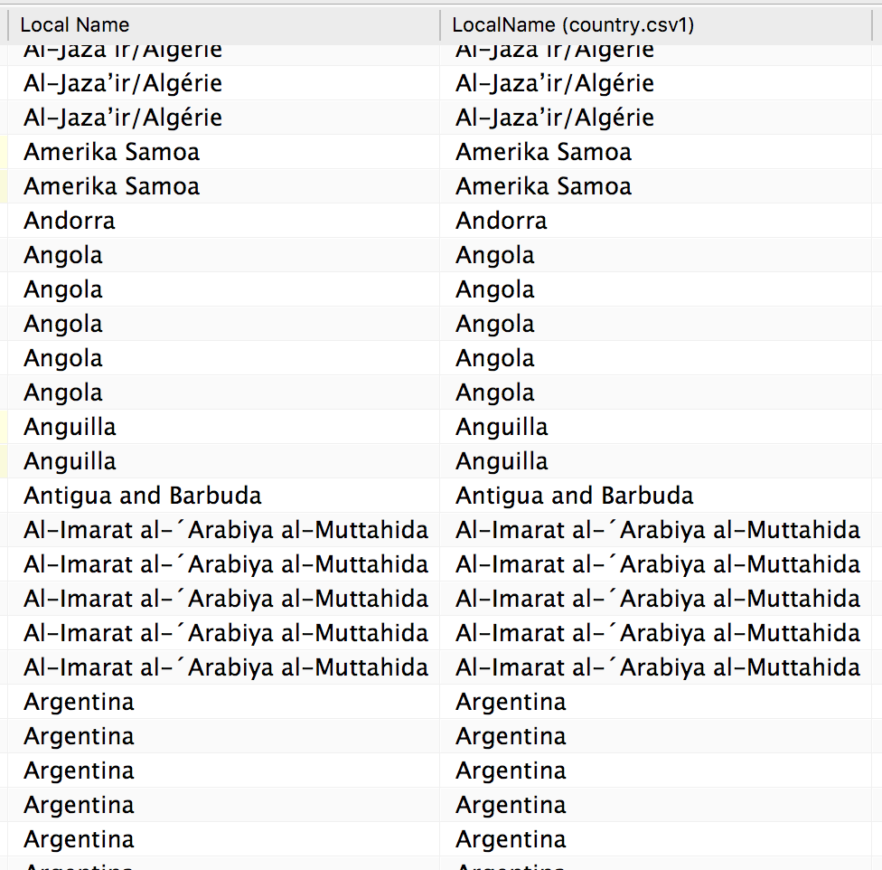
Using string functions to clean data
In our data, local country name has characters that might cause problems.
For example spaces, ‘, and / can be problematic since they can break up strings or cannot be interpreted in some programs.
Let’s make a column with the local names after data cleaning.
Notes:
The purpose of this slide is to introduce a use case for string functions by cleaning the local country names column in the world dataset.

Slide 10
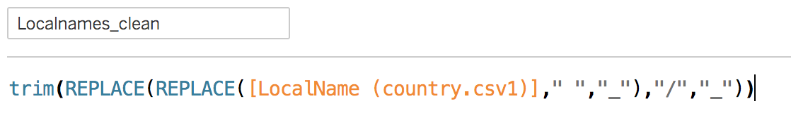
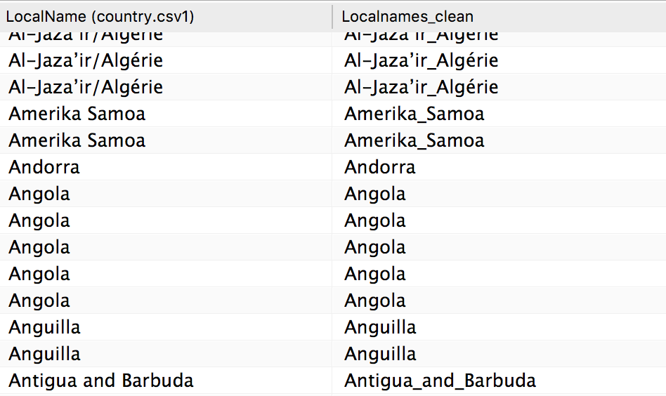
Nesting string functions
We can simplify the process by using nested replacements.
Notes:
The purpose of this slide is to execute the data cleaning of the local country names column in the world dataset.

Slide 11
Knowledge check 9

Slide 12
Exercise 9

Slide 13

Module completion checklist
Objective | Complete
Implement string calculations on a given dataset
Implement date calculations on a given dataset
Implement type calculations on a given dataset
Implement logic calculations on given dataset

Slide 14
End of Part 9

